Slide 1
YOLO
2022.08.10
강경수

Slide 2
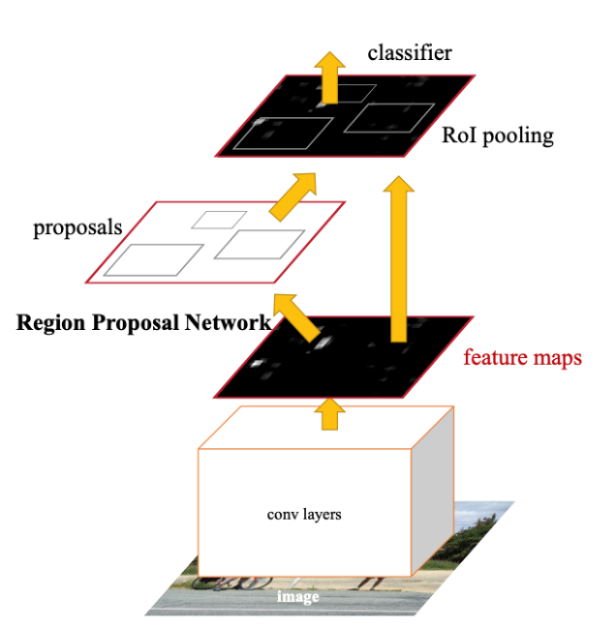
Topic – 2 stage detector
2 /
- Like R – CNN
Classification
Region proposal
feature extract twice
Slow & hard optimize
Only classification in ROI

Slide 3
Motivation & contribute
3 /
- yolo
Bbox extract and classification
By One stage feature extract
Contribution (1). Fast & easy optimization
- simple one stage neural network pipeline
(2). Generalizable learning and less background error
- using global feature map

Slide 4
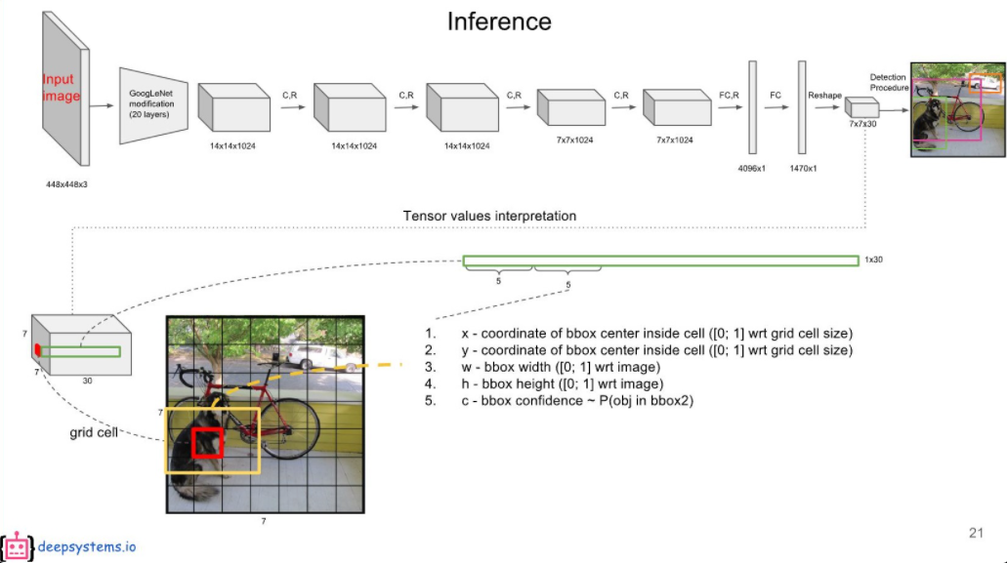
YOLO
4 /
- overview
Feature grid cell extract
Bbox & classification

Slide 5
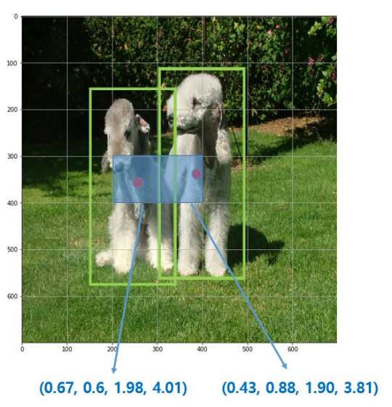
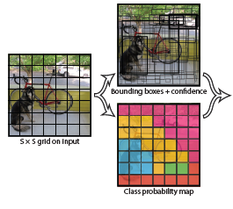
YOLO
5 /
- unified detection – grid cell
Divide input image into S*S grid
If the center of an object falls into a grid cell, that grid cell is responsible for detecting that object.
→ grid cell detect only center of an object

Slide 6


YOLO
6 /
- unified detection - Bbox
Each grid cell predicts B bounding box (in paper, B = 2)
Each bounding box have $x, y, w ,h ,pr$
$$Pr\left(Object\right)∗IOU$$

Slide 7
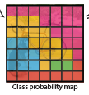


YOLO
7 /
- unified detection – classification
Each grid cell predicts C conditional class (in paper, C = 20)
Each bounding box have $c1, c2, c3…c20$
$$Pr\left(class|Object\right)$$
At test time, probabilities,

Slide 8
YOLO
8 /
- unified detection
bbox1
bbox2
class

Slide 9
YOLO
9 /
- Model architecture

Slide 10
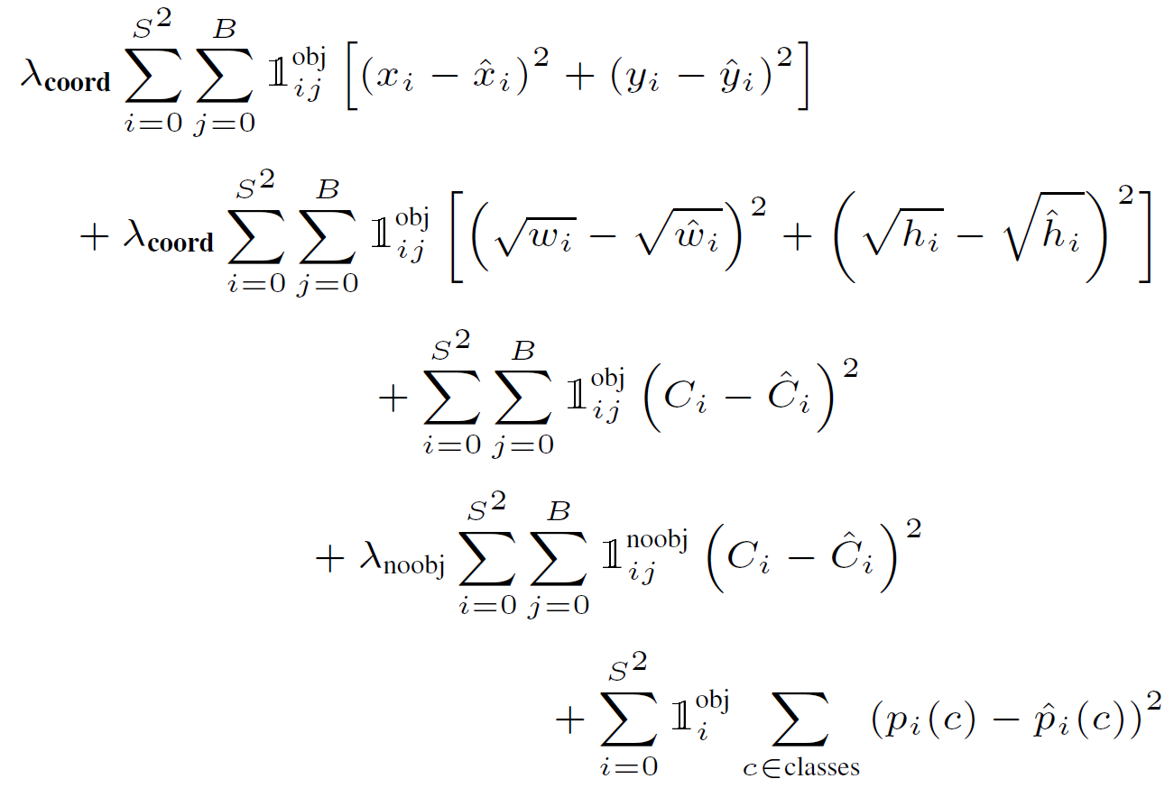
YOLO
10 /
- Training
sum squared error
Easy optimization.
but, not perfectly align
Hyper parameter tuning

Slide 11
YOLO
11 /
- Training
Small reflect Large box
Bbox localization error
Predict Localization
Conditioning error
Predict Background
classification error

Slide 12
YOLO
12 /
- limitation
(1). Hard to Small object detection
- each grid cell only one object predict
(2). struggles to unusual aspect ratios or configurations
(3). Small Bbox more effect loss error
- small box has a much greater effect on IOU.

Slide 13
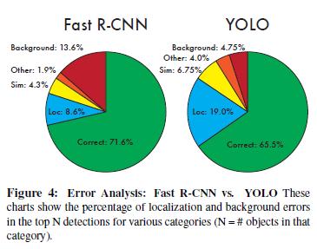
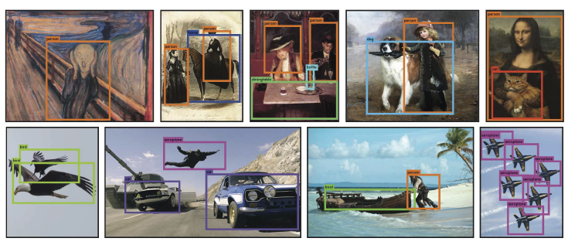
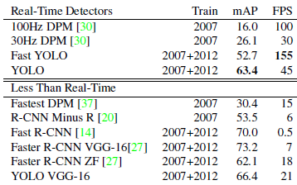
YOLO
13 /
- Experiments

Slide 14
Q & A.
14 /

